Slide 1
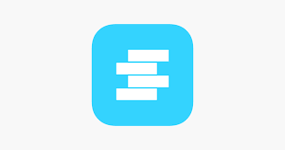
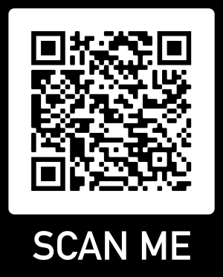
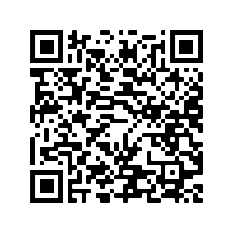
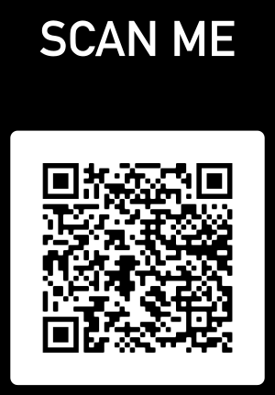
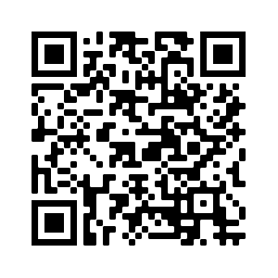
SWAY MEDICAL APP
Download the SWAY MEDICAL App.
Make sure your phone is charged.
Put phone on Do not disturb and go to a quiet room without distractions.
Turn volume up.
Unlock your screen so it can be viewed in landscape or portrait.
Make sure you are wearing tennis shoes and stand on a hard flat surface.
Follow the instructions given and do your best.
Codes are done by sport. If you play multiple sports choose only one sport code.
  Girls Basketball – 2NN25
  Boys Basketball - 73500
  Wrestling - 87162
  Baseball - 85183
APPLE
Information On Concussions
Google Play
Click this QR code to watch demo of each test

